Slide 1
DeepFashion:
Dress Type Detection
Prepared by
Ahjeong Yeom, Akhir Syabani, Kenji Laurens, Steven Wu
Deep Learning & Image Recognition, Spring 2022

Slide 2
Today’s Agenda
Abstract
EDA & Preprocessing
Model Building
Modeling 1: Image Classification (ResNet, VGG, AlexNet, 2 Custom Models)
Modeling 2: Object Detection (YOLO)
Model Deployment/ Management
Conclusion
DeepFashion:
Dress Type Detection

Slide 3
Abstract
Dataset
DeepFashion
Problem:
Fashion requires deeper understanding: it keeps evolving and producing new style variations.
Classifying different types of clothing is important as a base for more advanced works of deep learning in fashion.
Approach:
Object detection model solves the problem of recognizing types of clothes.
From the the whole dataset of 200,000+ images on various clothing pieces, our team narrowed down the scope to female dress category and then focused on detecting three dress types (Mini, Midi, Maxi) due to hardware limitations.
Results:
>70% of accuracy detecting three types of dress.
Category: Dress
Images
Types/ Attributes
Modeling 1:
Image Classification
Modeling 2:
Object Detection

Slide 4
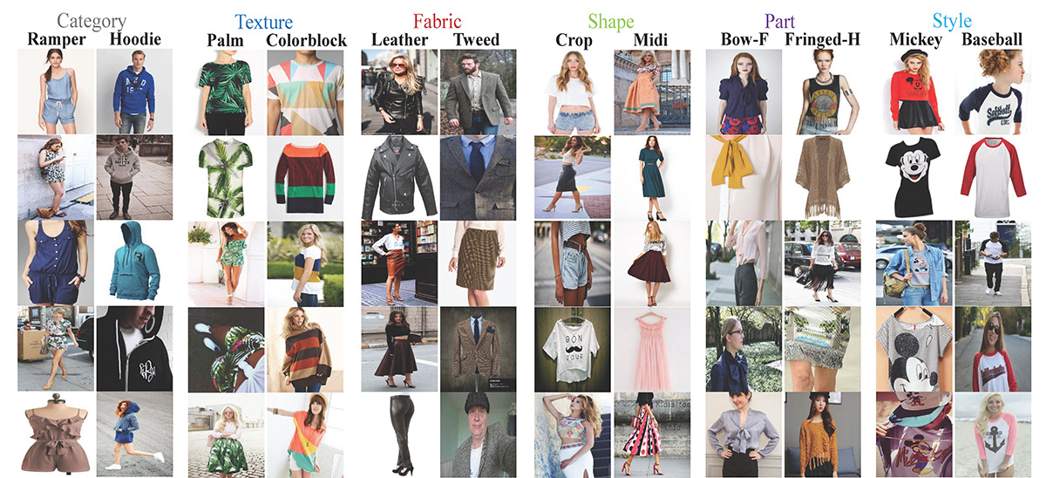
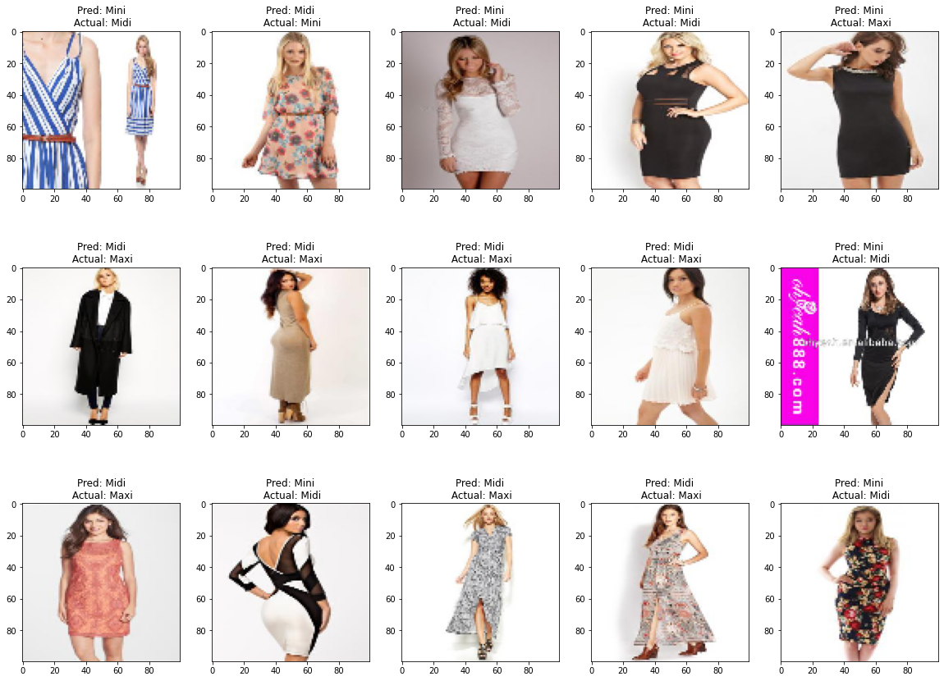
EDA: Data Description
Dataset: DeepFashion Attribute Prediction Dataset (Source)
Multimedia Laboratory, The Chinese University of Hong Kong
Images and attributes of 289,222 clothing articles of various types and categories
Exactly 1000 attributes:
simple attributes (dress, trousers, shirt, blouse, etc)
complex attributes (plaid, a-line, collared, sheer, etc)
Each clothing can and do possess multiple attributes
Mostly frontal and focused on the clothes only
Bounding boxes included, to further narrow down the image to each clothing only
Background images are varied: empty or some environment
Various resolutions, mostly around 300 x 300
Selected samples: female dress category
(attributes/types: mini, midi, maxi
https://mmlab.ie.cuhk.edu.hk/projects/DeepFashion.html

Slide 5
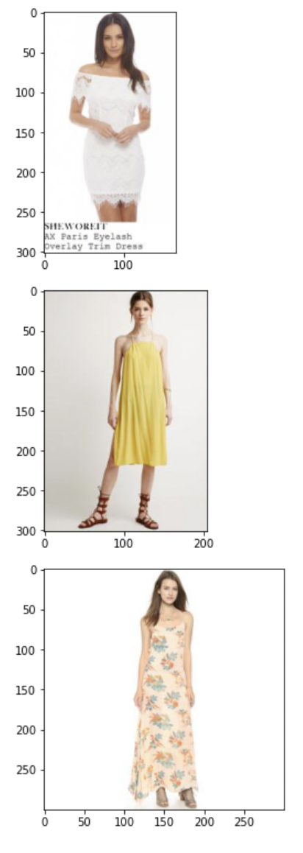
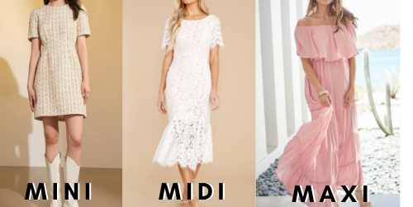
EDA: Data Description
Examples from Dataset
Different Dress Types:
Three dress types were trained given the restriction of the project scope.
Mini dresses: above the knee height around the thighs
Midi dresses: crops at knee length
Maxi dresses: longer than knee length, often to the ankles

Slide 6
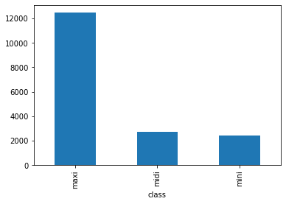
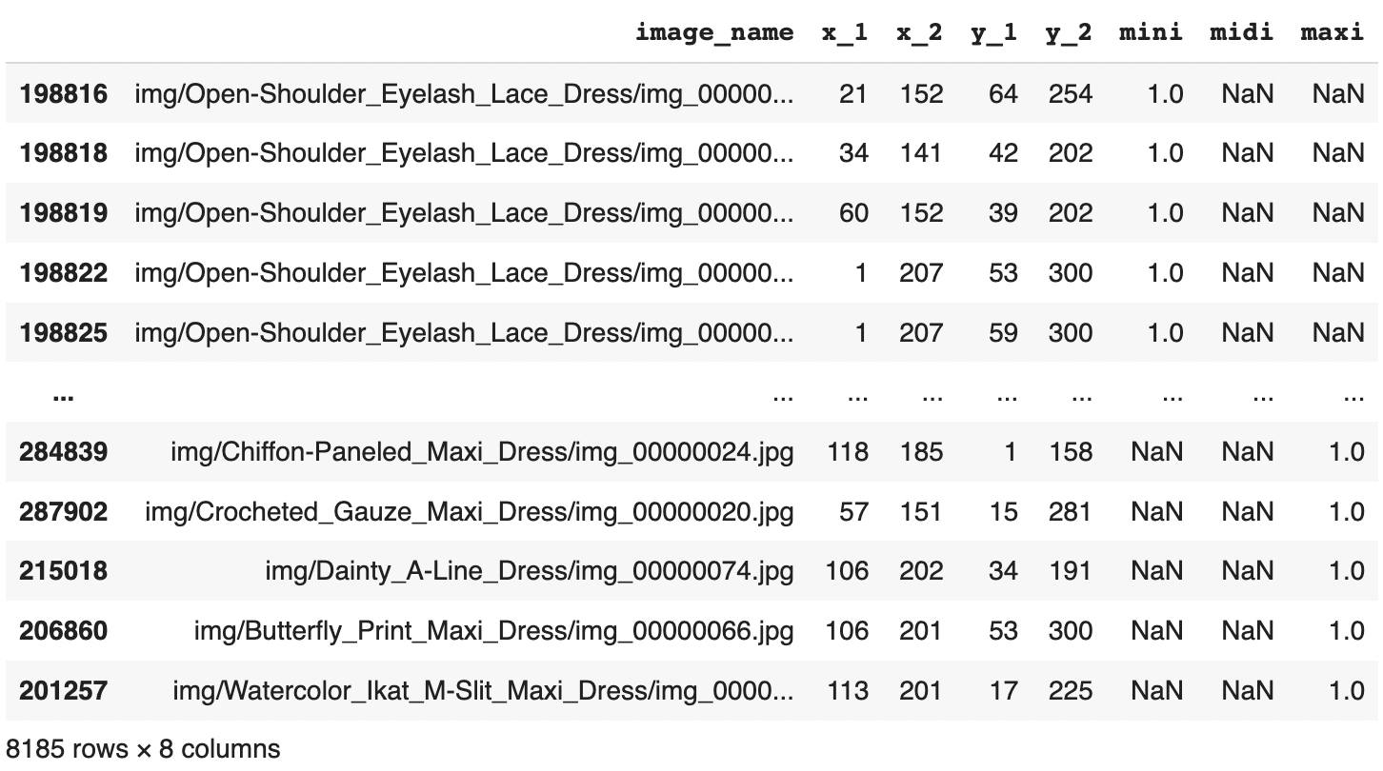
EDA & Preprocessing:
Data Engineering & Feature Selection
Raw Data:
Multiple tables as .txt files + ~3GB img zip file
Selection:
Image_name contains ‘Dress’
Attributes: ‘Mini’, ‘Midi’, ‘Maxi
Cleaning:
Removed mislabeled images:
No labels
Multi-labeled
Sampling & Balancing Data:
Pre-processing:
Attributes are one-hot encoded (fill NA = 0)
Two separate image arrays:
full image,
cropped to the bounding boxes
All standardized and resized to (100, 100, 3) numpy array
Other pre-processing to follow each model requirements
___________________________
___________________________
___________________________
___________________________
Merged
 | Clean Set | Sample
Maxi | 12,468 (70%) | 3,000 (36%)
Midi | 2,756 (16%) | 2,756 (34%)
Mini | 2,429 (14%) | 2,429 (30%)
______________________________________________________________________________________________________________________________________________________

Slide 7
Modeling 1: Image Classification
ResNet50, VGG16, AlexNet, Custom Model 1 & 2
ResNet50 | VGG16 | AlexNet | Custom Model 1 | Custom Model 2
Layers: 48 convolutional 1 max pooling 1 avg pooling Weight: imagenet Activation: ReLU Added dense layer with softmax Early stopping Parameters: 23 million | Layers: 13 convolutional 3 fully connected 5 max pooling Max pooling Weight: imagenet Activation: ReLU Added dense layer with softmax Early stopping Parameters: 138 million | Layers: 5 convolutional 3 fully connected 3 max pooling Activation: ReLU Added dense layer with softmax Early stopping Parameters: 62 million | Layers: 4 convolutional 3 fully connected 2 max pooling 4 dropouts 1 batch normalization Activation: ReLU, softmax Early stopping Parameters: 146 thousand | Layers: 6 convolutional 3 fully connected 3 max pooling 3 dropouts 6 batch normalization Activation: ReLU, softmax Early stopping Parameters: 28 million
Notes:
Describe the algorithms implemented and their pros and cons with respect to the data • Perform detailed model performance evaluation and comparison with appropriate metrics

Slide 8
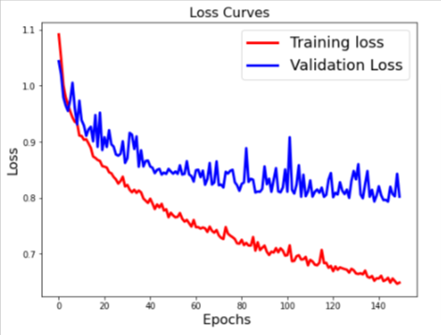
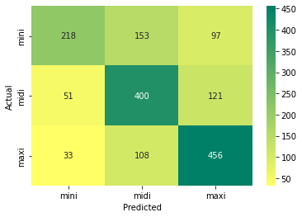
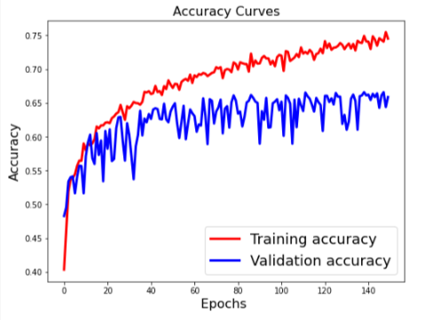
Modeling 1: Image Classification
ResNet50
Epoch: 150/150
loss: 0.6483
accuracy: 0.7450
val_loss: 0.8019
val_accuracy: 0.6585
Est. runtime: 50ms/step
Good/acceptable accuracy, though validation set shows slower rate of improvement in each epoch

Slide 9
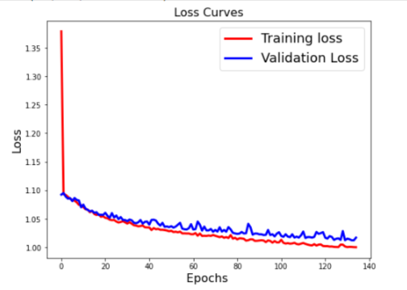
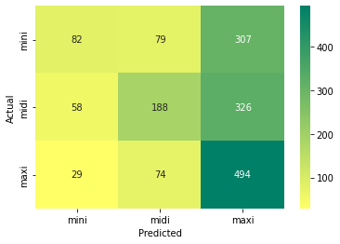
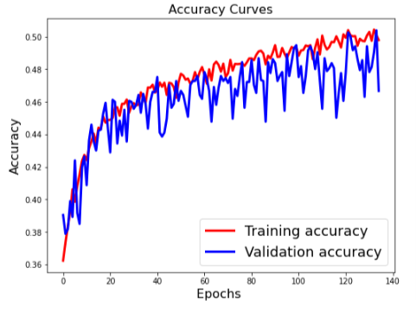
Modeling 1: Image Classification
VGG16
Epoch: 135/150
(early stopping)
loss: 1.0002
accuracy: 0.4980
val_loss: 1.0169
val_accuracy: 0.4667
Est. runtime: 50ms/step
Lower accuracy, yet consistent performance across training and validation (minimized overfitting)

Slide 10
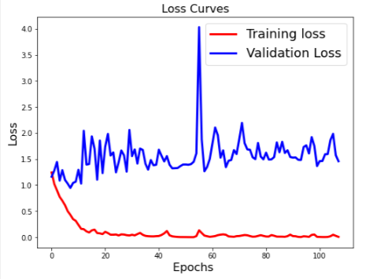
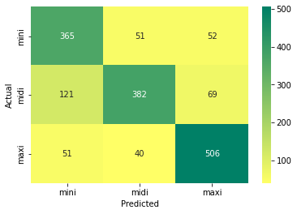
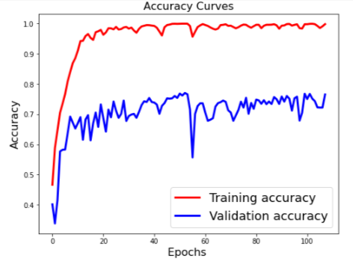
Modeling 1: Image Classification
AlexNet
Epoch: 108/150
(early stopping)
loss: 0.0056
accuracy: 0.9985
val_loss: 1.4573
val_accuracy: 0.7654
Est. runtime: 40ms/step
High accuracy, yet large gap / overfitting

Slide 11
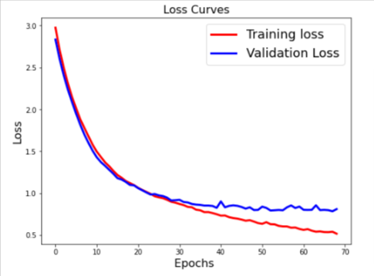
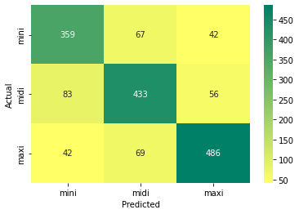
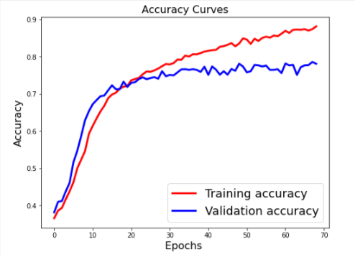
Modeling 1: Image Classification
Custom Model 1
Epoch: 69/150
(early stopping)
loss: 0.5162
accuracy: 0.8812
val_loss: 0.8094
val_accuracy: 0.7807
Est. runtime: 30ms/step
Simpler customized architecture with good/acceptable performance with decent consistency across training and validation

Slide 12
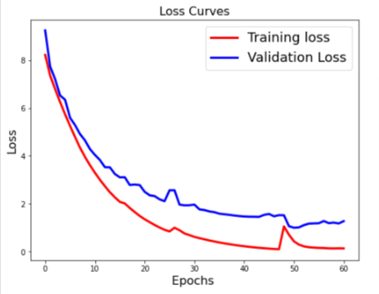
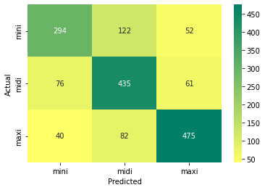
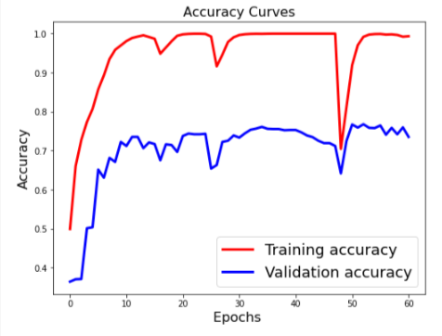
Modeling 1: Image Classification
Custom Model 2
Epoch: 61/150
(early stopping)
loss: 0.1309
accuracy: 0.9934
val_loss: 1.2711
val_accuracy: 0.7355
Est. runtime: 103ms/step
More complex customized architecture with good/acceptable performance but produce overfitting results

Slide 13
Modeling 1: Image Classification
Comparison and Evaluation
ResNet50 | VGG16 | AlexNet | Custom Model 1 | Custom Model 2
Loss Training: 0.65 Validation: 0.80 Accuracy: Training: 75% Validation: 66% # Layers: 50 # Params: 23mn Est. runtime: 50ms/step | Loss Training: 1.00 Validation: 1.02 Accuracy: Training: 50% Validation: 47% # Layers: 16 # Params: 138mn Est. runtime: 50ms/step | Loss Training: 0.01 Validation: 1.46 Accuracy: Training: 99% Validation: 77% # Layers: 8 # Params: 62mn Est. runtime: 30ms/step | Loss Training: 0.52 Validation: 0.81 Accuracy: Training: 88% Validation: 78% # Layers: 7 # Params: 146k Est. runtime: 40ms/step | Loss Training: 0.13 Validation: 0.74 Accuracy: Training: 99% Validation: 74% # Layers: 9 # Params: 28mn Est. runtime: 103ms/step
Notes:
Tried several models, both from scratch and transfer learning
Also tried full image and cropped model
Models created from scratch range from 100,000-ish trainable params to 20 million (bullshit model)
Tried transfer learning with VGG, ResNet and AlexNet
All came to similar scores at about 70% test accuracy, the best being BSModel2 with ~78%
Transfer learning doesn’t help much, nor did full size images

Slide 14
Modeling 1: Image Classification
Limitations and Further Improvements
Data:
More distinction on ‘mini’ & ‘midi’ classifications
Further clean-up on labeling (handling mislabeled data)
Use higher image resolutions
Execution:
Use larger hardware/software capacity
Try deeper layers
Further experiment with grayscale images (initial assessment: no difference)
Add noise for better model generalization
Notes:
Data labeling could be better (made by nerds)
Some dresses are mislabeled
We could have made corrections to the data
Distinction between Mini and Midi can be subjective
Hardware limitations
Increase image resolution
Deeper model
Maybe try grayscale instead of color
(I tried, doesn’t seem to make a difference)
More noise in the dataset would improve the model and generalize better

Slide 15
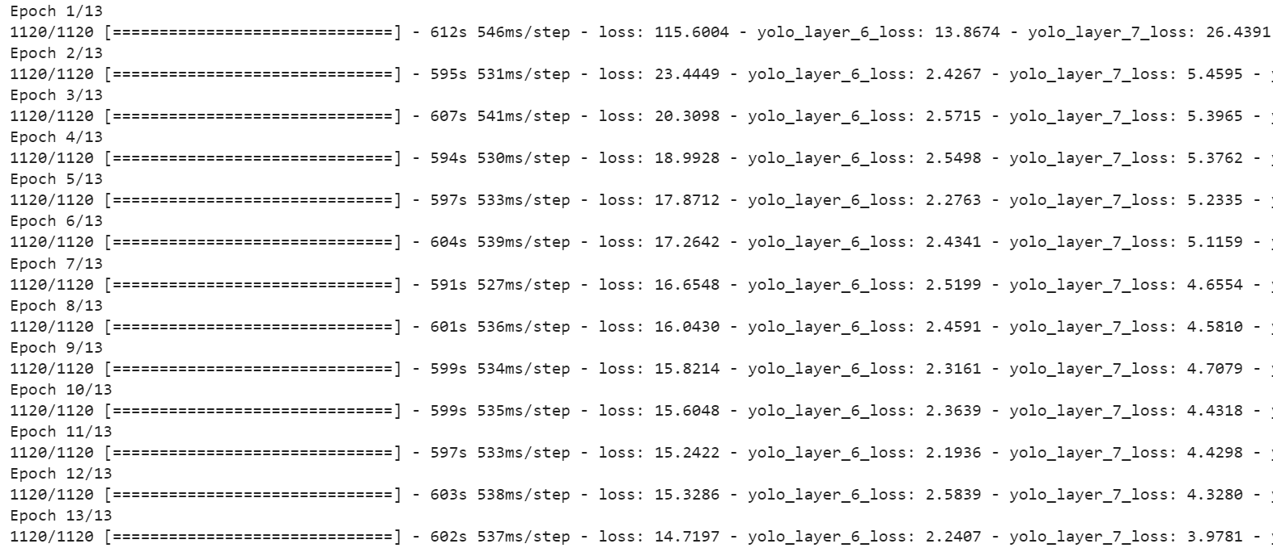
Modeling 2: Object Detection
YOLO v3 - Summary
Modeling Design
Tried to fit to a YOLOv3 custom object detection using ImageAI API A smaller subset was was used (only about 230 images for each category) Created annotations for all images Annotations are in PASCAL Visual Object Classes (VOC) format Used the bounding boxes provided
Execution
Training took a very long time, 13 epochs took 2 hours Ran out of Colab GPU runtime allocation
Notes:
Describe the algorithms implemented and their pros and cons with respect to the data • Perform detailed model performance evaluation and comparison with appropriate metrics

Slide 16
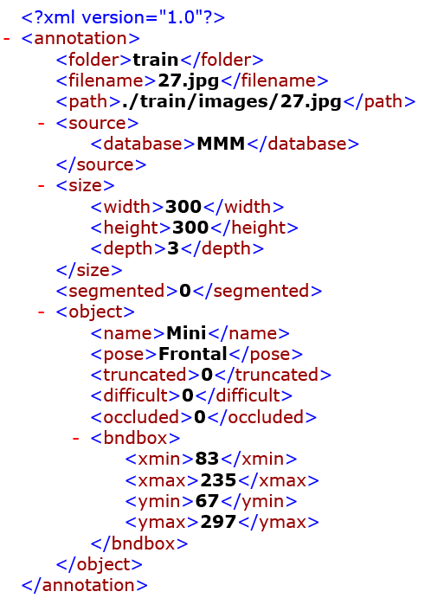
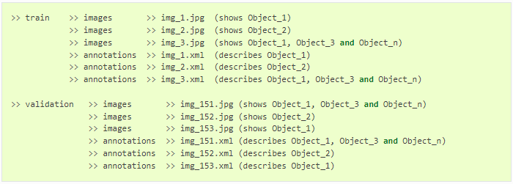
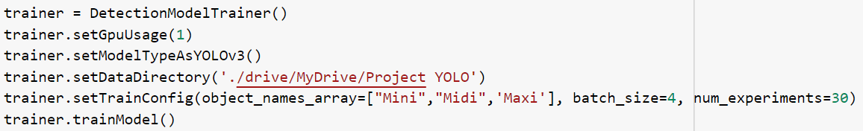
Modeling 2: Object Detection
YOLO v3 - Video Detection: Model Creation & Engineering
Full images used (uncropped to bounding boxes)
Full resolution used for each image
Bounding boxes were already part of dataset
Had to retrain the model from scratch according to using ImageAI API

Slide 17

Modeling 2: Object Detection
YOLO v3 - Custom Object Detection Video
Pinterest video of a woman trying out different dresses
Tried all mini, midi and maxi dresses
Text showing type of dress is from the video and not annotated by the model
Model prediction is unfortunately annotated out of frame
Due to training images lacking much noise
https://www.pinterest.com/pin/mini-midi-maxis-oh-my-video--209628557647083293/

Slide 18
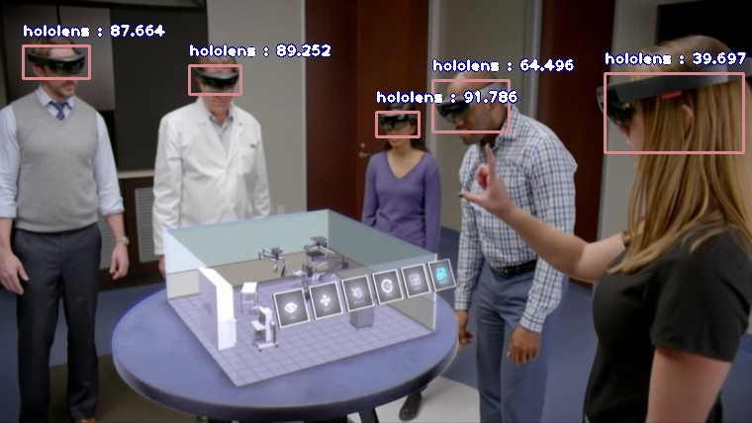
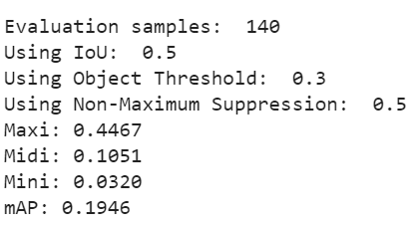
Modeling 2: Object Detection
YOLO v3 - Evaluation
Unable to create robust model due to lacking GPU allocation
The model was most confident with Maxi dresses, and almost unable to detect Mini dress
Very low mAP score (Mean Average Precision)
Our training images lack any noise
All images are highly focused on the dresses themselves
Might cause the model to assume the dress should take up the whole screen
Since label annotations are placed above detection bounds, our demo video did not show any annotations

Slide 19
Modeling 2: Object Detection
YOLO v3 - Limitations and Further Improvements
Use images that has a background instead of the whole image (noisy images)
Run more epochs
Try transfer learning with trained detection model or other general models
Updated version of YOLOv5 can be used for improvement

Slide 20
Use Case
Image Classification:
Fashion Recommendation Powered By DL
Attributes extracted from image classification can help enhance the fashion companies’ recommendation to consumers based on purchase or search history
User can hover on image and see specific article label and this hover action can micro-logged and used for building fine-tuned recommendation as fashion outfit photos generally contain many items in one outfit.
Object Detection
Video scene labeling is a popular DL application. Now fashion object detection can add more complex information to the description of the video scene. (ie. A woman with leopard maxi dress and blue eyes are carrying her weekender bag)
Tiktok and Reels can use this algorithm to extract information from videos and read the real-time fashion trends globally

Slide 21
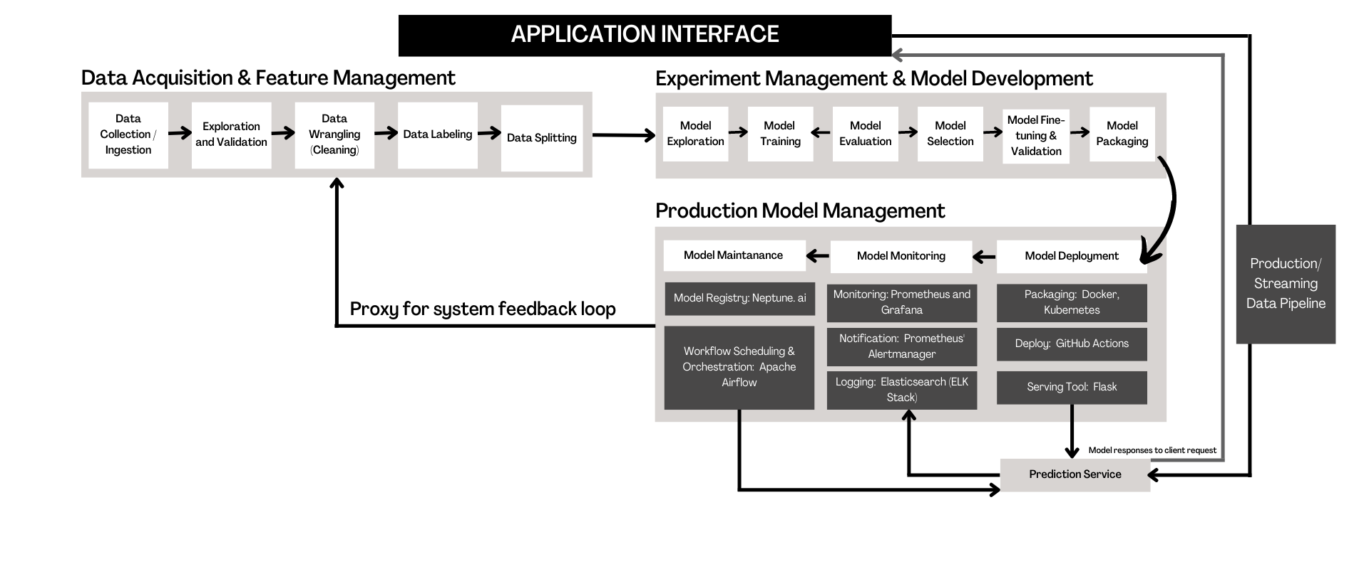
Model Deployment/Management
https://towardsdatascience.com/deploying-an-image-classification-web-app-with-python-3753c46bb79
https://www.analyticsvidhya.com/blog/2020/07/deploy-an-image-classification-model-using-flask/
https://www.fairwinds.com/blog/heroku-vs.-kubernetes-the-big-differences-you-should-know
https://machinelearningmastery.com/update-neural-network-models-with-more-data/
https://neptune.ai/blog/mlops-architecture-guide
Notes:
Provide a mechanism (architecture) on how the model would be deployed • Provide a plan for model maintenance and a process for parameter update.
MLOps
Operationalize the proposed to the production.
How would you deploy the model?
How would the consumers use this model?
How frequently do you expect to retrain the model?
How would you monitor the model?
Every time you capture, prediction?
Deploying the model as a service?
Streamlit?

Slide 22
Model Deployment/Management
Given that new input data will come in rapidly (fashion evolves rapidly), dynamic training architecture is optimal where model is re-trained with constant data feed into the data pipeline
Integration of automated data versioning, monitoring, and continuous deployment of the model is essential using a scheduling tool/ trigger-based orchestration tool
Kubernetes will be a good scalable option for our runtime environment as it is portable, executable anywhere and model-agnostic. Also, it can optimize the resources for ML workload

Slide 23
Conclusion
Selecting and preparing the right training data is crucial
Ensure enough variance
Correct labeling
Use image augmentation when possible
Pre-trained models sometimes are not the way to go
Need to balance computing power and expected accuracy
Always need to retrain the model and fine-tune the parameters and layers for a better fit
Careful adjustment to manage model tendency to overfitting

Slide 24
Thank You!
References:
https://mmlab.ie.cuhk.edu.hk/projects/DeepFashion/AttributePrediction.html
https://towardsdatascience.com/deploying-an-image-classification-web-app-with-python-3753c46bb79
https://www.analyticsvidhya.com/blog/2020/07/deploy-an-image-classification-model-using-flask/
https://www.fairwinds.com/blog/heroku-vs.-kubernetes-the-big-differences-you-should-know
https://machinelearningmastery.com/update-neural-network-models-with-more-data/
https://towardsdatascience.com/deploying-an-image-classification-web-app-with-python-3753c46bb79
https://www.analyticsvidhya.com/blog/2020/07/deploy-an-image-classification-model-using-flask/
https://www.fairwinds.com/blog/heroku-vs.-kubernetes-the-big-differences-you-should-know
https://machinelearningmastery.com/update-neural-network-models-with-more-data/
https://neptune.ai/blog/mlops-architecture-guide

